Slide 1


Introduction to Gas Leak Detection in Industries
Safeguarding workers and communities from the devastating risks of industrial gas leaks through proactive detection and mitigation.
ABDULLAH NADEEM N (210701008)
ARAVIND D (210701031)
ARAVIND S (210701033)

Slide 2
Importance of Preventing Explosions
Gas leaks expose workers to hazardous fumes, increasing the risk of fires and explosions that can cause severe injury or loss of life.
Uncontrolled gas leaks can contaminate the surrounding environment, harming local ecosystems and communities.
Explosions and accidents due to gas leaks result in costly equipment damage, production downtime, legal liabilities, and reputation damage.

Slide 3
EXISTING SYSTEM
Current gas leak detection methods rely on manual inspections and outdated sensor technologies.
Periodic visual inspections miss many leaks
Aging sensors provide unreliable, inaccurate readings
Lack of real-time monitoring and centralized data management
Slow response times to gas leak incidents
Insufficient worker training on gas leak detection and safety protocols

Slide 4
PROPOSED SYSTEM
Innovative IoT-based gas leak detection system with real-time monitoring and centralized management.
1
Continuous Sensing: Wireless, cloud-connected sensors continuously monitor gas levels across the facility
Immediate Alerts: Automated notifications when gas concentrations exceed safe thresholds
Centralized Visibility: Web-based dashboard displays real-time data, historical trends, and incident logs
Proactive Maintenance: Predictive analytics to identify potential leak sources and schedule preventative action

Slide 5



IoT Components: Arduino, MQTT Sensors
Arduino Microcontroller
MQ Series Sensors
IoT Connectivity
Cloud-connected sensors monitor gas levels and trigger instant alerts.
Enables real-time monitoring, remote access, and centralized data management.
Powerful, versatile platform for building robust gas detection systems.

Slide 6

Abstract: Designing a Gas Leak Detector System
Sensor Integration
Wireless Connectivity
Real-time Alerts
Seamlessly integrate gas sensors with the Arduino microcontroller to continuously monitor gas levels across the facility.
Develop a responsive system that can trigger immediate notifications when gas concentrations exceed safe thresholds.
Utilize secure MQTT protocols to transmit real-time sensor data to a cloud-based monitoring platform.

Slide 7

Hardware Requirements: Sensors, Microcontroller, Communication Modules
1
Gas Sensors: Methane, propane, and hydrogen sulfide sensors to detect a wide range of potentially hazardous gases
Arduino Uno: A robust and programmable microcontroller to process sensor data and coordinate system operations
WiFi/Ethernet Module: Enables secure, high-speed data transmission to the cloud-based monitoring platform
Power Supply: Reliable and stable power source to ensure continuous operation of the gas detection system

Slide 8
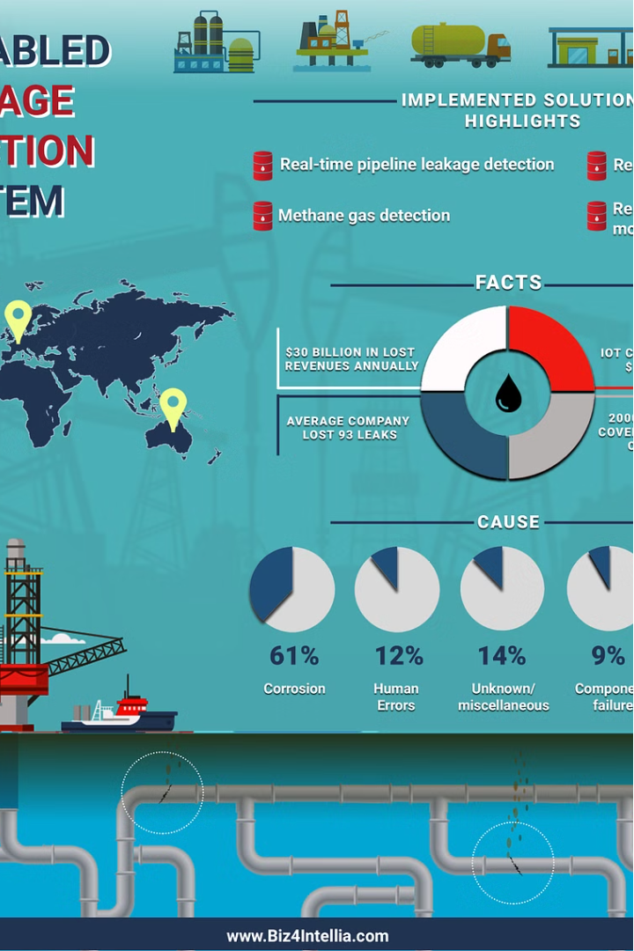
Software Requirements: Firmware, Cloud Integration, Monitoring Dashboard
Firmware - Customized software that runs on the Arduino to manage sensor readings, data processing, and alerts to ensure reliable and responsive gas leak detection.
Cloud Integration - Secure data transmission and storage on a cloud platform enables centralized monitoring, analysis, and management of gas leak detection across the entire facility.
Ml model for detecting Anomaly – we use machine learning to understand the sensor data and detect anomalies to provide real time alerts..

Slide 9




System Architecture and Data Flow
Sensor Inputs
Gas sensors continuously monitor environment and transmit data to Arduino.
Arduino Processing
Microcontroller analyzes sensor data and triggers alerts for unsafe levels.
Cloud Integration
Sensor data and alerts securely transmitted to cloud monitoring platform.

Slide 10
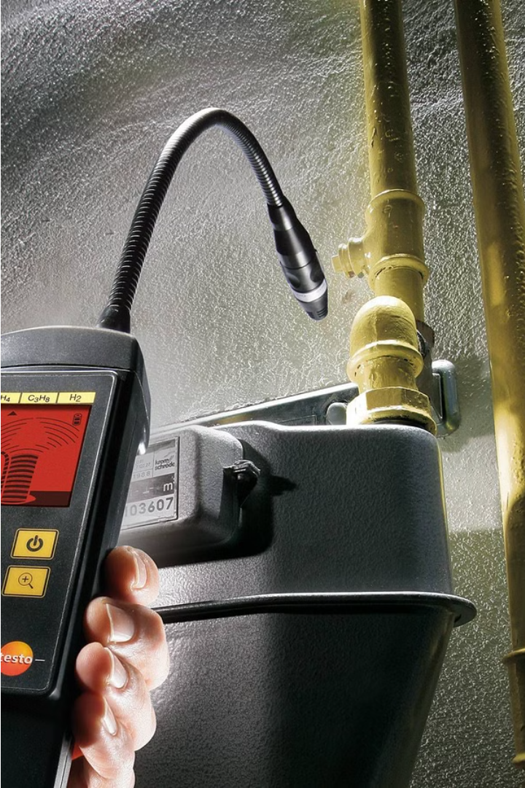
Conclusion and Future Enhancements
The IoT-powered gas leak detection system ensures real-time monitoring, early warnings, and centralized management to safeguard workers and the environment.
Future enhancements could leverage machine learning for predictive leak detection, automated shut-off valves for emergency response, and mobile apps for remote oversight.

